Slide 1
Efficient Web-based Software Project Monitoring, Tracking and Control System
Team members Academic Guide
Sowmiya.R-711715205706 Mrs.Dhanalakshmi.B,
Haripriya.N-711715205705 Assistant professor.
Iswarya.K-711715205702
Industrial Guide
Mrs.Ambli

Slide 2
Problem statement
The project managers, ensure that products or services delivered to customers, meet their expectations for better quality and satisfaction.
Statistical Process Control is the use of statistical tools and techniques to analyze a process or its outputs to control, manage, and improve the quality of the output or the capability of the process .

Slide 3
Abstract
Project Monitoring Tracking, and Controlling system provides a highly-standardized , automated technique of project management, planning management and budget across a diverse group of activities of employees.
This system oversees all the tasks and metrics necessary to ensure that the approved and authorized project is within scope, on time, and on budget so that the project proceeds with minimal risk.
Monitoring of each project progress status as compared to the planned project progress.

Slide 4
Literature survey
Work time management system
WTM is an application presenting an example of usage popular and open Web technologies accessible on the Internet.
Web technologies used in the application are divided in two main groups.
The architecture of the WTM application is based on the MVC design pattern (model, view, controller), which provides a division of the project on a layer of view, layer of view and layer of controller. Such a division supports ease of further modification and improvement of functionality.

Slide 5
Analytical expense management system
Although the development of communication technologies allowed the elaboration of multiple users' Web applications (e.g. information storage), there are still many improvements on many applications to be done and uncovered areas.
Expense management systems on Web application area are still in their infancy.
Expense management software is widely spread in companies and most of time supported by their intranet.

Slide 6
Modules
Client module
Admin module
Project module
Employee module
Project scheduling
Time tracking
Report

Slide 7
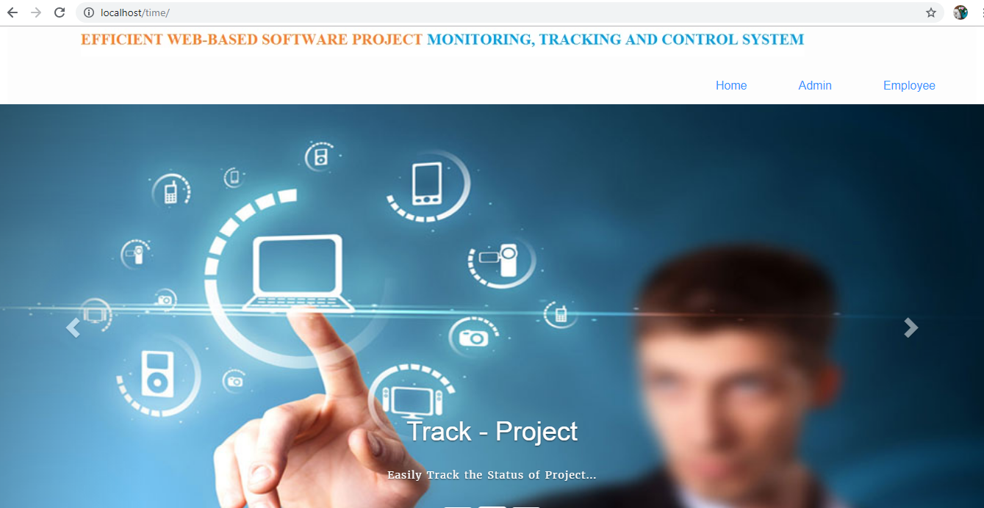
Home page

Slide 8
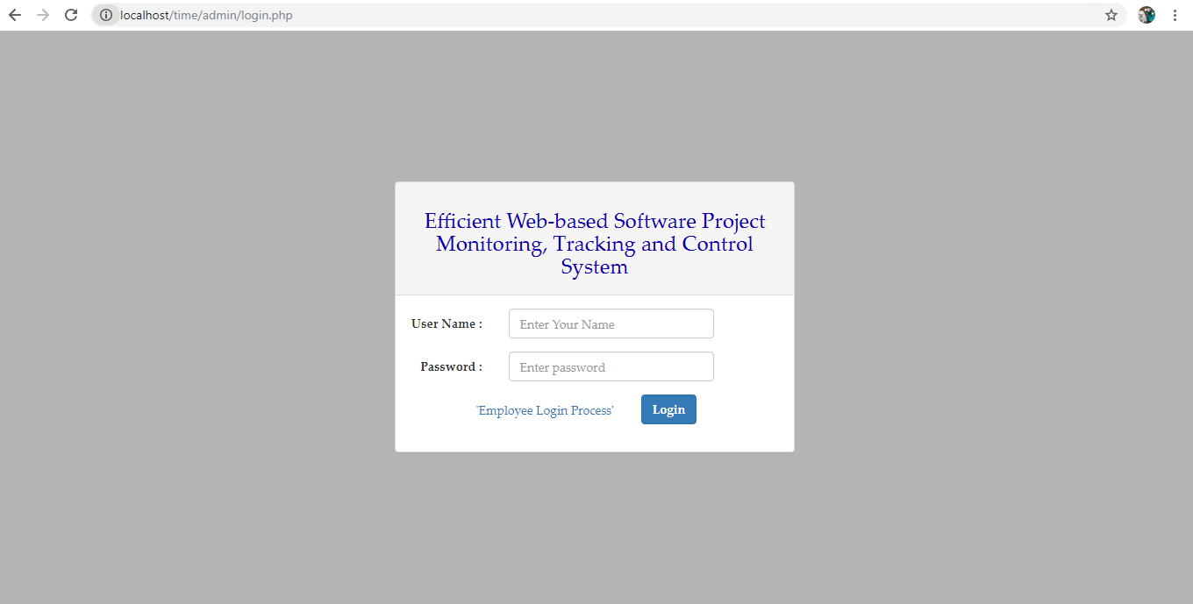
Admin login

Slide 9
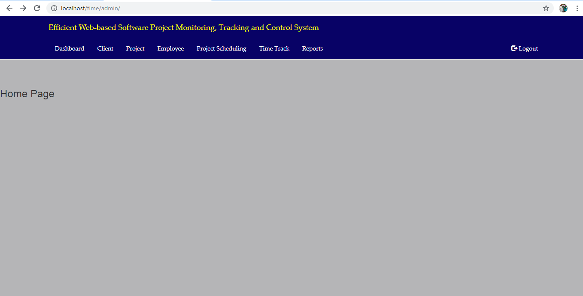
Admin dashboard

Slide 10
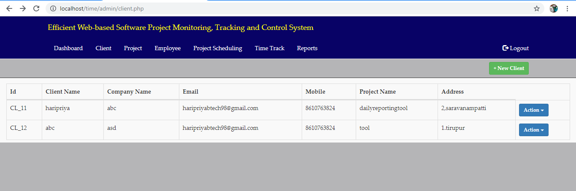
Client details

Slide 11
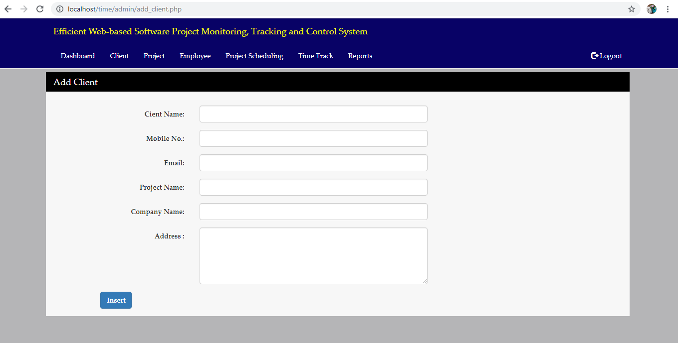
Add client details

Slide 12
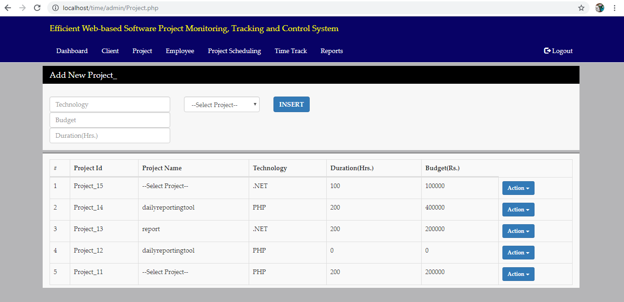
Project

Slide 13
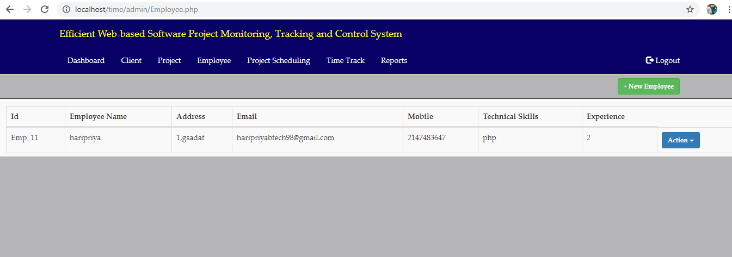
Employee

Slide 14
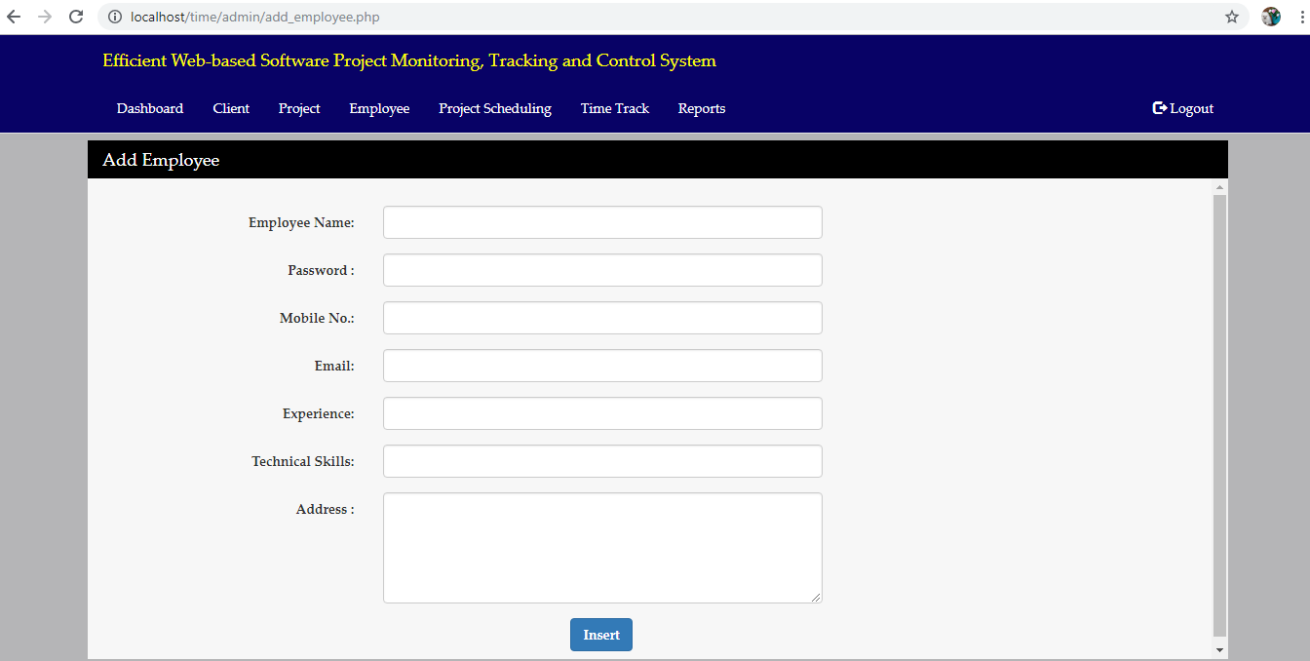
Add new employee

Slide 15
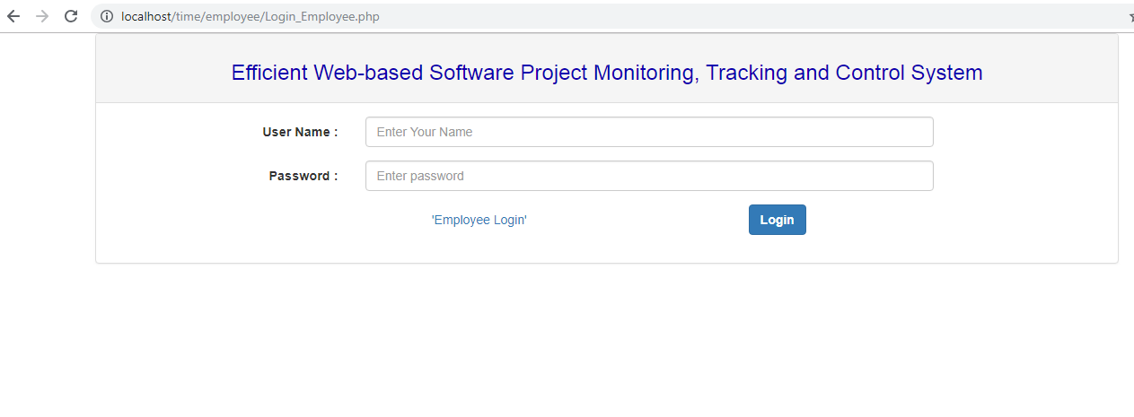
Employee login

Slide 16
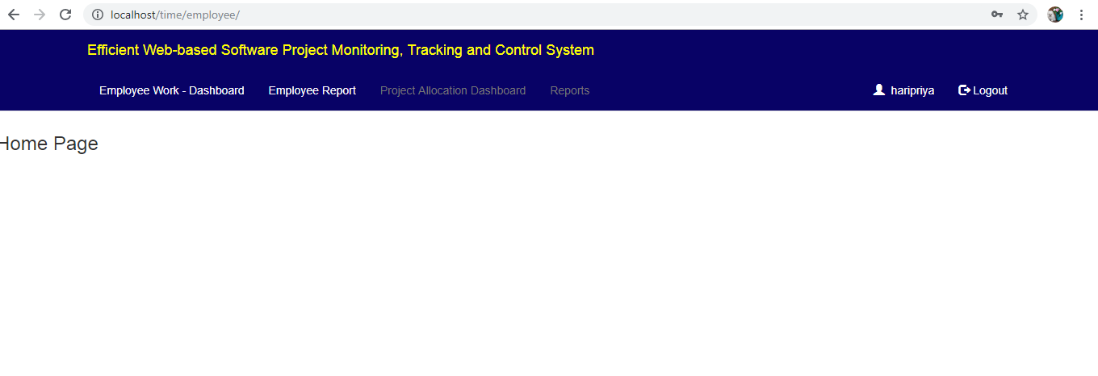
Employee Details

Slide 17
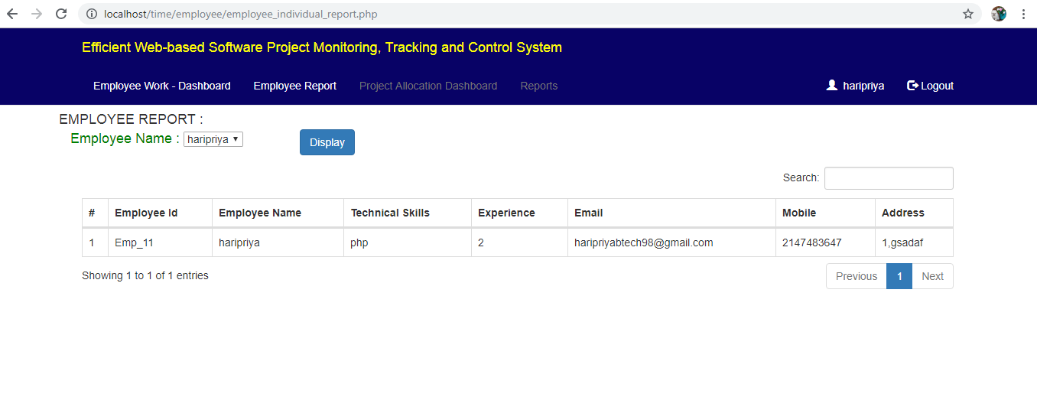
Employee Report

Slide 18
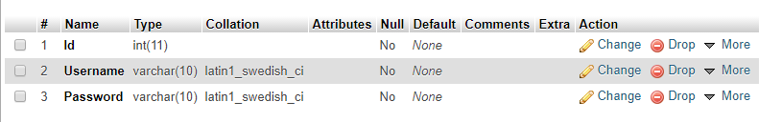
Table Design Admin

Slide 19
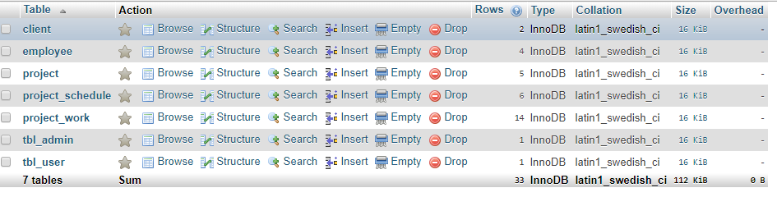
Table Design Client table

Slide 20
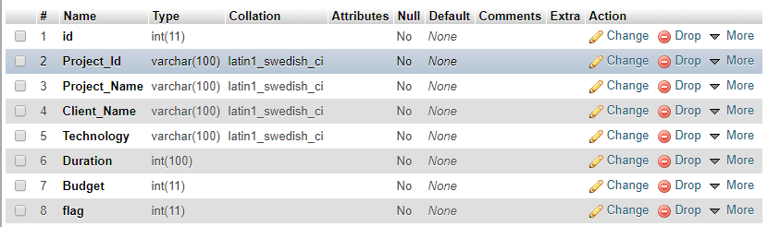
Project Table

Slide 21
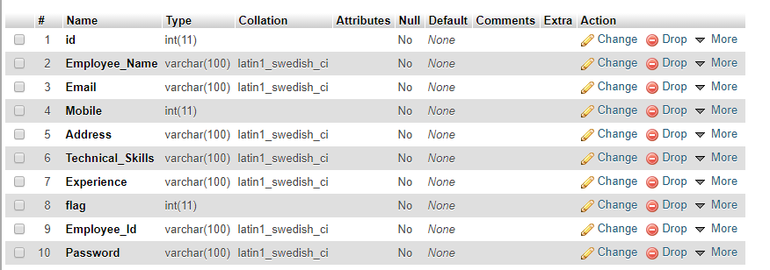
Employee Table

Slide 22
Architecture Diagram
Employee details
Project Allocation
Project module load entry
Project module allocation
Project work load process
Employee work time entry

Slide 23
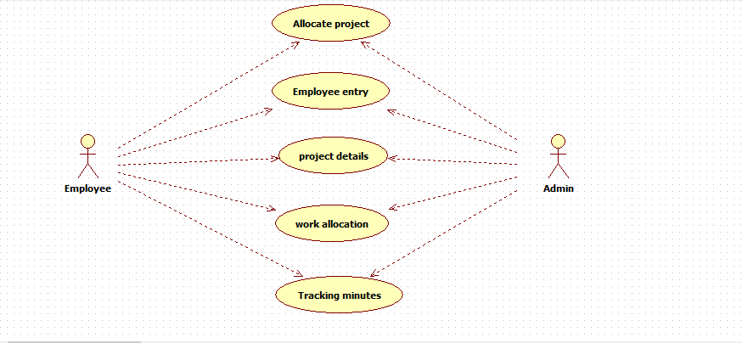
Use case Diagram

Slide 24
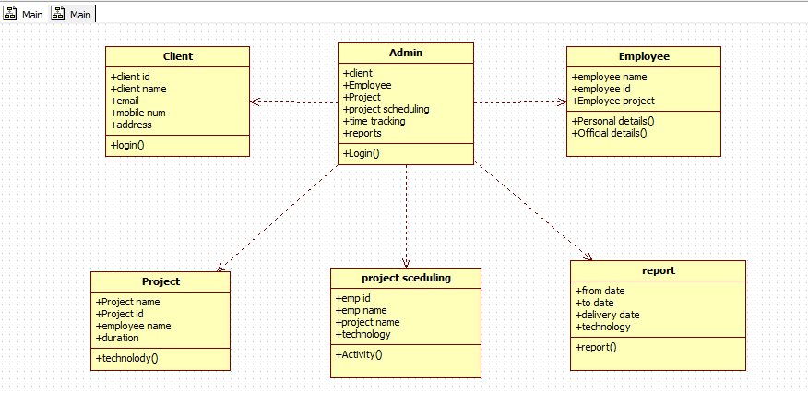
Class Diagram

Slide 25
E-R Diagram
Project name
Client code
Client name
Client password
Id
Client name
Project description
Project
Project requirement
Client
Admin name
Project
Admin password
Project scheduling
Project
Admin
Project name
Employee
Duration
Qualification
Start time
End time analysis
Employee id
Employee password
Employee name

Slide 26
Requirement analysis
FRONT END : HTML , PHP
BACK END : MYSQL
Client Side Script : JavaScript
Style Sheet : CSS3

Slide 27
Testing plans
Testing is a set of activities that can be planned in advance and conducted systematically.

Slide 28
Conclusion
Time track system manages the operation of the employee work system.
The project status can be easily tracked with the help of the web based application with centralized web based server.
The chart report with the metrics can be managed ,with easy to measure the project system.

Slide 29
Any Queries?

Slide 30
Thank you!

